Slide 1

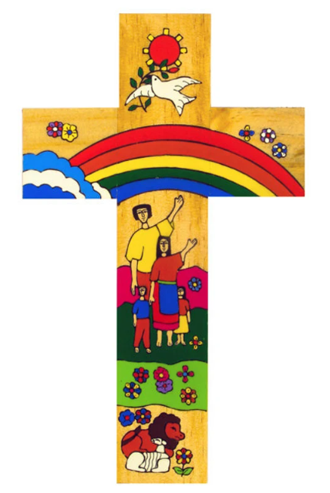
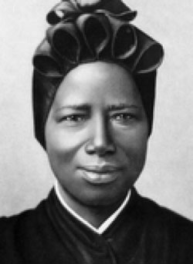
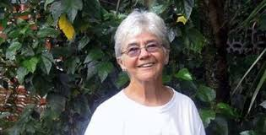
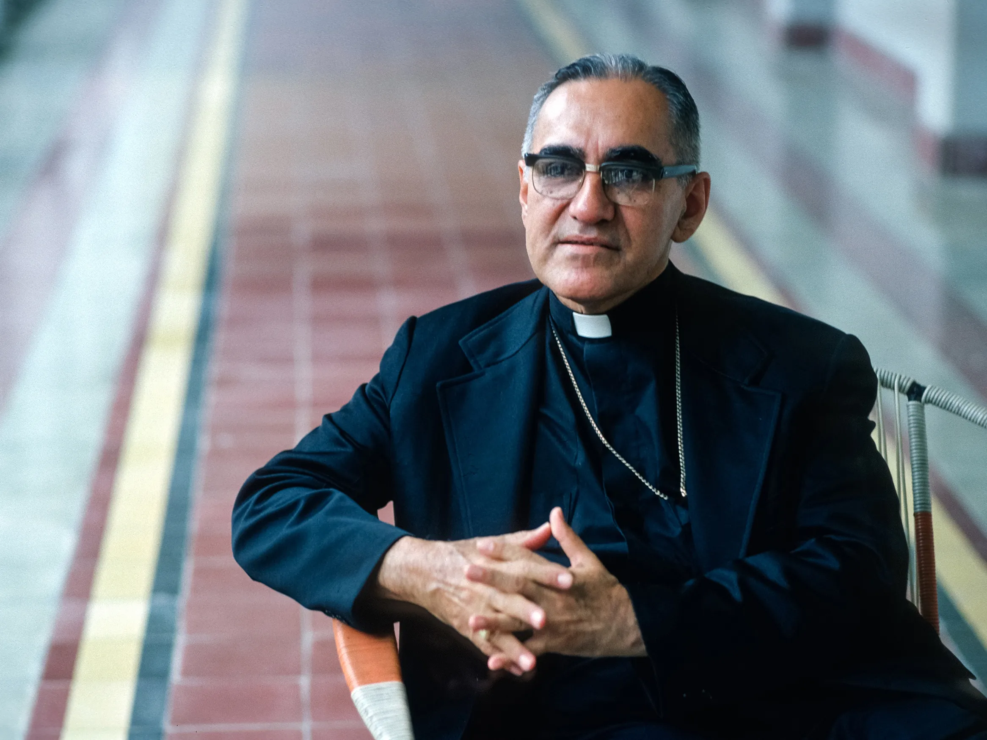
Catholic Social Teaching in R.E
In KS3 we follow the Source to Summit programme.
We look at how the ancient stories told in the Bible continue to influence how modern Catholics live today.
We consider questions related to the pronciples of Catholic Social Teaching
What can we do to protect creation?
Can businesses act selflessly?
How can we respond to world hunger?
A study of people how have influence
Catholic Social Teaching
Sister Dorothy Stang
Martyred in 2005 for campaigning for the protection of the rainforest.
Oscar Romero
# common good
#solidarity
Josephine Bakhita
# dignity of the human person
A hub of faith and learning with Christ at its centre

Slide 2

Catholic Social Teaching in R.E
In KS4 we follow the AQA GCSE programme.
We study Catholic thinking using three sources of wisdom
Scripture – the insights of the Biblical writers
Tradition – the experience of different generations
Magisterium– the teachings of the Church from the apostles onwards
In the section of the course entitled Theme C we look at
Human dignity and religious freedom
Human rights
Rights and responsibilities
Wealth creation and exploitation
Poverty
Catholic Social Teaching
A hub of faith and learning with Christ at its centre

Slide 3
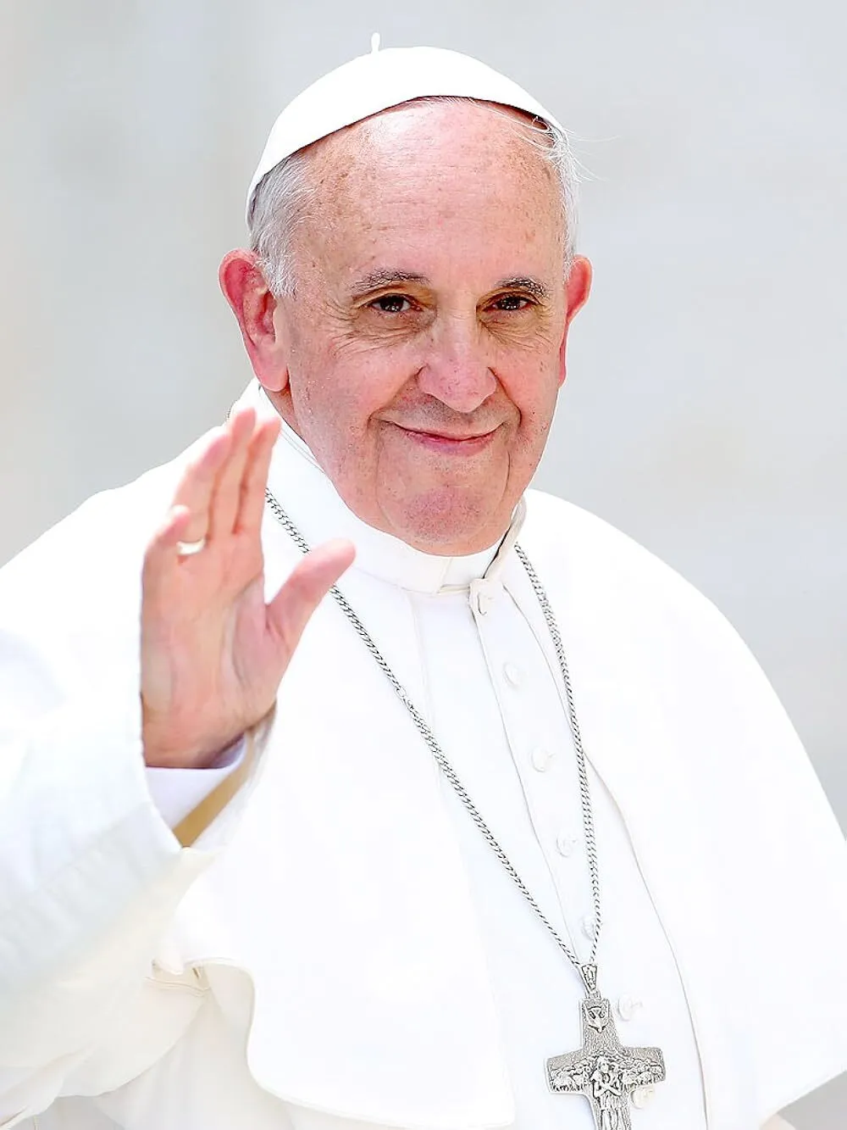
Catholic Social Teaching in R.E
In KS5 students follow a programme of study which includes units on poverty and exploitation.
They engage with Catholic Social Teaching by considering events in the world. They consider
the response of others around the world
the response of the Catholic church
Their own response to the issue
Catholic Social Teaching
Pope Francis Jan 2025,
“AI should help promote critical thinking, and not just train “young people how to amass information and generate quick responses". Education is …about taking a risk in the tensions between the mind, the heart and the hands," it said.
Human beings are themselves considered consumer goods to be used and then discarded.
A hub of faith and learning with Christ at its centre

