Slide 1

Computing and IT

Slide 2

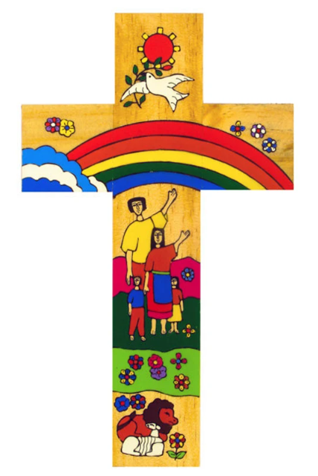
Catholic Social Teaching in computing
In KS3 We introduce a topic called “online safety” this relates to the principle of the “creation and the environment” students research on how internet use impacts the environment. Students learn how to be kind to each other online and use of appropriate language, as well as how to stay safe when you interact with online strangers. We are considering the responsibilities we have to others online and offline?
Catholic Social Teaching
In KS4 We teach about topics relating to ethical use of computers, reflecting on pope Francis’s quote “The environment is God's gift to everyone.” This relates to the principle of the “creation and the environment” & “the common good” because students learn about how our actions can shape the future of our environment and how the poorest nations on Earth are experiencing damaging effects of dumping computer parts in landfills.
In KS5 We teach digital literacy, we explore how digital behaviour affects the planet (e.g. energy use from streaming or cloud storage). This also relates to the principle of the environmental effects on storing data in large data centres. We Investigate real-world data centres and their carbon footprints and how this affects climate change
Computing & IT
In KS3,4,5 We teach about topics relating to how we can use technology in a way that honours God’s creation. We again link these topics in daily reflections of learning recall questions that reminds us and emphasises on the goodness of caring for our creations.
A hub of faith and learning with Christ at its centre

