Slide 1

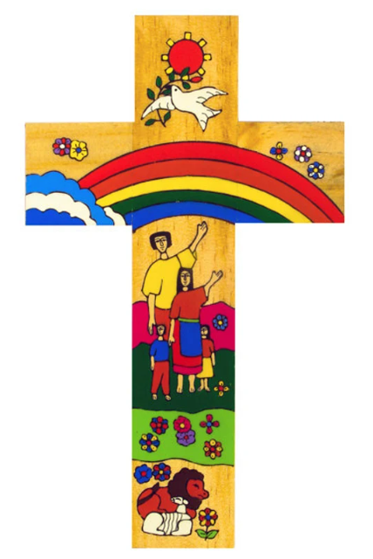
Catholic Social Teaching in English
Catholic Social Teaching
In KS3 we teach about the stewardship of creation to Yr 7 in their poetry module on the wonders of the natural world and the seasons.
A hub of faith and learning with Christ at its centre

