Slide 1

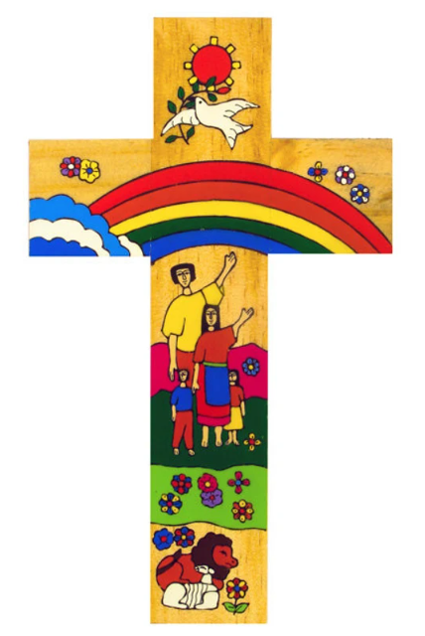
Catholic Social Teaching in English
In Year 9 we teach the dignity of work and participation. Through the study of J.B. Priestley’s play, ‘An Inspector Calls’, we explore the belief that the human person should always come before the pursuit of profit. The play also reminds us that the fruits of the earth belong to everyone and, therefore, also teaches us that we are all part of the common good: no-one person should feel entitled to ‘take’ the earth.
Catholic Social Teaching
A hub of faith and learning with Christ at its centre

