Slide 1

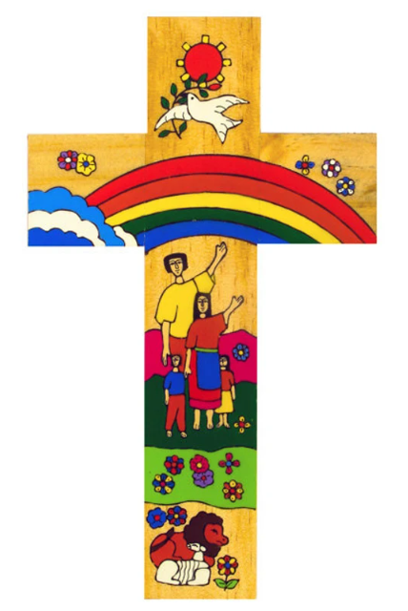
Catholic Social Teaching in Geography
In KS3 we teach about topics called “Shaping the Land” which relates to the principle of the “creation and the environment” because students learn about the physical processes of erosion, transportation and deposition, as well as tectonic processes, and how they create landforms found along rivers, coasts and at plate boundaries.
In KS3 & KS4 we teach about topics relating to climate change which relates to the principle of the “creation and the environment” & “the common good” because students learn about how our actions can shape the future of our climate and how the poorest nations on Earth are experiencing more damaging effects than the wealthier nations.
Catholic Social Teaching
In KS3, KS4 & KS5 we teach about topics relating to managing natural hazards which relates to the principle of the “option for the poor” because students learn about how natural disasters, such as earthquakes and tropical storms, can be managed to ensure that people are protected from these hazards and how aid can be distributed to help the neediest people.
In KS3 & KS4 we teach about topics relating to employment & the economy which relates to the principle of the “dignity of work and participation” because students learn about how concepts such as globalisation have affected our world, as well as how small scale factors affect industrial location.
A hub of faith and learning with Christ at its centre

