Slide 1

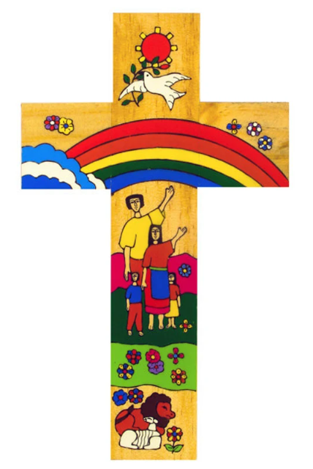



Catholic Social Teaching in MFL: KS3
In Key Stage 3 pupils learn about different cultures and traditions, and we talk about character and personality with reference to Christ’s teachings. These relate to the principles of solidarity and dignity because pupils are learning that we are one global family and we should treat others with love and respect.
Pupils learn about the world around us and environmental issues. This links to the principle of creation and the environment because they learn to express how we should protect our world.
We also learn about a range of Catholic celebrations in French, Spanish, and Polish speaking communities, encouraging empathy and unity.
Catholic Social Teaching
A hub of faith and learning with Christ at its centre

Slide 2
Catholic Social Teaching in MFL: KS4 & 5
In Key Stage 4, pupils learn how to discuss environmental problems and solutions in more detail, expressing our responsibilities as global citizens. We talk about charity, volunteering and fair trade which link to the principle of the option for the poor, focusing on promoting justice and peace in our world.
Catholic Social Teaching
In Key Stage 5, tolerance and respect are promoted throughout our courses. History topics emphasise the importance of peace and the common good. Topics such as immigration, social justice, multiculturalism teach tolerance and respect. Catholic Social Teaching within MFL helps to create compassionate, globally-aware citizens who approach language learning as a bridge to justice and solidarity.
A hub of faith and learning with Christ at its centre

