Slide 1


Catholic Social Teaching in Music
In KS3 we teach students to create music together and work on their ensemble skills in performance. This related to the Catholic Social Teaching Principals of solidarity and participation as students put aside their differences to explore their creativity.
Catholic Social Teaching
We also teach about how music is used for positive social change focusing on protest songs, artist campaigns, and the positive effects of musical events and activities on our community and individuals. The principal of rights and responsibilities is a key component to this topic. The protest songs cover a range of topics from war and violence to global warming and pollution which link to the principals of the common good and stewardship of creation.
A hub of faith and learning with Christ at its centre

Slide 2
Catholic Social Teaching in Music
In KS4 we teach about musical styles from around the world which often get overlooked in Western arts. Students learn about the unique contextual origins of these styles which links to the principal of human dignity.
Catholic Social Teaching
We also teach composition workshops which focus on allowing students to explore their creativity in new and effective ways. They work as a class initially to write their own music to various prompts and the principals of participation and solidarity within that group are emphasised throughout these workshops.
A hub of faith and learning with Christ at its centre

Slide 3

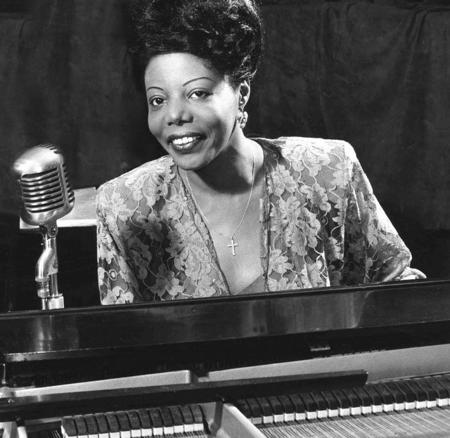
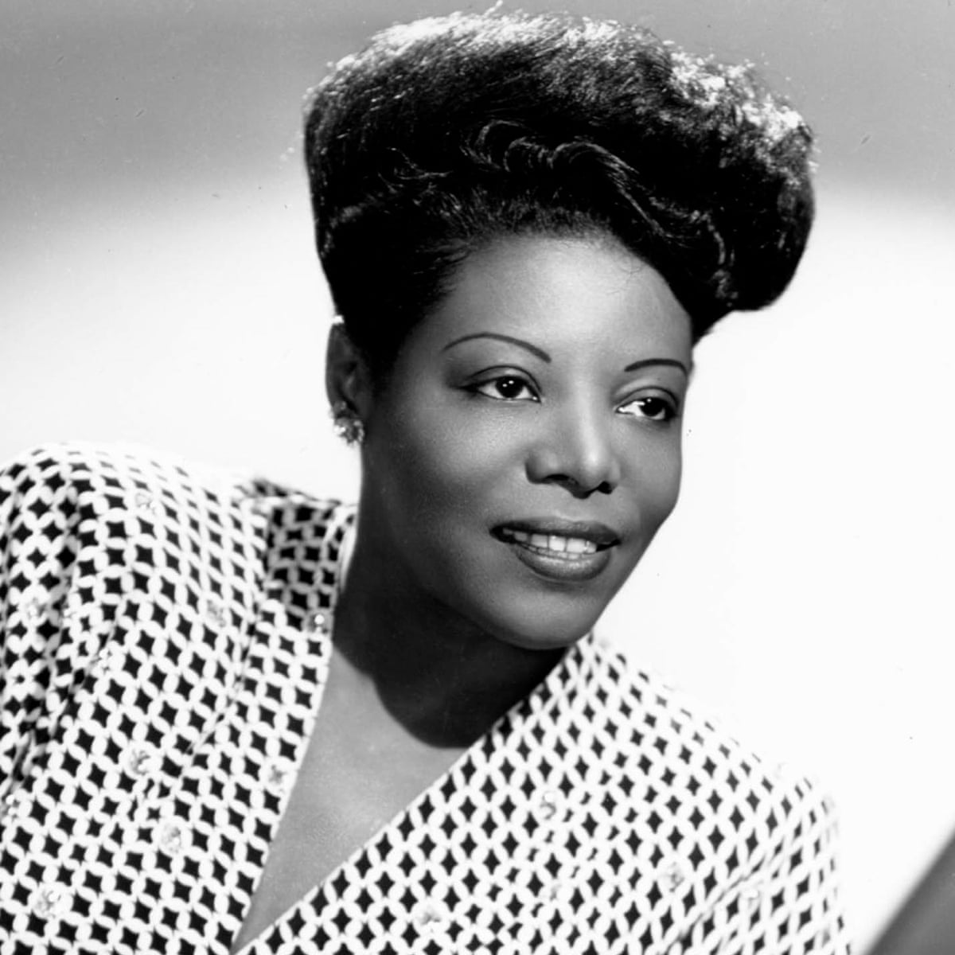
Department: Music
Mary Lou Williams
Essential information: Mary Lou Williams was an American jazz pianist and composer. She experienced troubles in her childhood home life and later on in her marriage. She converted to Catholicism in a time of distress and found a passion for serving God by utilising her exceptional gifts to create music.
Born: 1910
Died: 1981
Place of birth: Atlanta, Georgia
Why is this person of interest to this department?
She brought a love of God into jazz spaces and challenged the social preconceptions surrounding the genre and the people associated with it. Her aim was to sanctify spaces that people assumed were redolent of sin. Williams saw jazz music as a balm for those who suffer and used the music itself to spread the messages of God in her compositions. She was highly resilient after suffering herself in a society full of prejudice.

