Slide 1

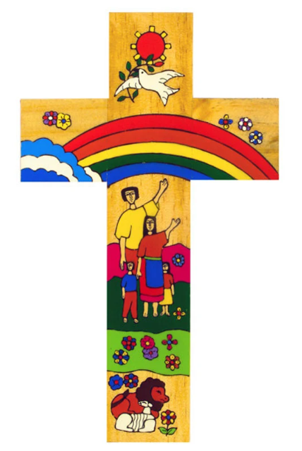
Catholic Social Teaching in Art and Photography
In KS3 we teach about identity, community, and the environment, which links to the Catholic principle of the dignity of the human person and care for creation, because students explore how each person is unique and valued, and how we are responsible for the world around us. For example, students create expressive self-portraits, use natural forms and recycled materials in their work.
In KS4 we teach about social justice, identity, and global responsibility, which links to the Catholic principles of rights and responsibilities and the common good, because students develop more personal and purposeful artwork that responds to real-world issues. For example, they explore themes such as identity, protest through photography, mixed media and drawing, learning how creative work can be a powerful response to injustice.
In KS5 we teach students to take ownership of personal and global themes such as dignity, injustice, and freedom of expression, which links to the Catholic principles of solidarity and the dignity of the human person, because students explore the role of the artist in promoting truth and justice. For example, they investigate contemporary issues through documentary photography, conceptual art, and mixed media, producing thoughtful and independent projects that respond to the world around them.
Catholic Social Teaching
A hub of faith and learning with Christ at its centre

