Slide 1

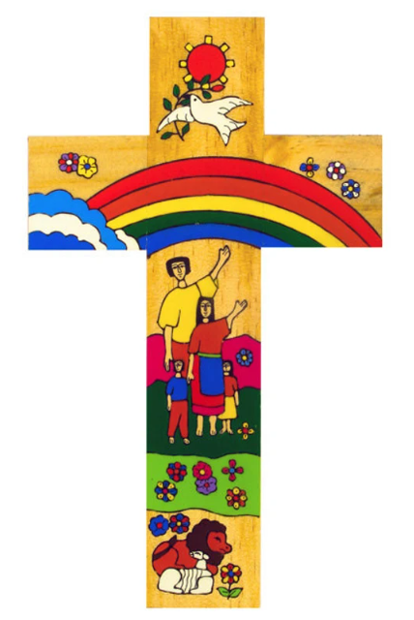
Catholic Social Teaching in KS3 Biology
In KS3 biology we teach about the challenges faced by pollinators, exploring the importance of insects and effects of toxins in the environment relating to the principle of care for creation
Catholic Social Teaching
In KS3 biology we teach about understanding deficiency diseases and skeletal diseases which relating to the principle of options for the poor and solidarity
In KS3 biology we teach about the challenges faced by pollinators, exploring the importance of insects and effects of toxins in the environment relating to the principle of care for creation
A hub of faith and learning with Christ at its centre

Slide 2
Catholic Social Teaching in KS3 Chemistry
In KS3 chemistry we teach about the changes of state used to provide clean drinking water relating to the principle of options for the poor
Catholic Social Teaching
In KS3 chemistry we teach about the products of combustion and the impact of acid rain relating to the principle of care for creation
In KS3 chemistry we teach about the mining of metals and the impact on local communities relating to the principle of solidarity and care for creation
A hub of faith and learning with Christ at its centre

Slide 3
Catholic Social Teaching in KS3 Physics
In KS3 physics we teach about generating electricity to provide energy for all relating to the principles of dignity of work and options for the poor
Catholic Social Teaching
In KS3 physics we teach about the transfer of energy relating to the principle of care for creation
In KS3 physics we teach about the reduction of effort required to do work and make processes more energy efficient relating to the principles of common good and dignity of work
A hub of faith and learning with Christ at its centre

