Slide 1

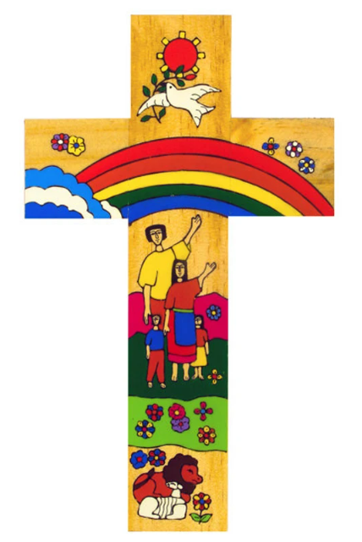
Catholic Social Teaching in History
In Year 7, we teach about the topics of Subsidiarity and Common Good. Focusing on areas such as the impact of Feudalism on the ordinary people of England, the powerful making decisions without considering the voices of all and how these lack of rights lead to issues such as the peasant's revolt and the reformation.
In Year 8, we teach about the topics of Human Dignity and Preferential Option for the Poor. Focusing on why the Slave Trade was seen as acceptable by the people of the 17th and 18th centuries and how this lack of dignity was mirrored in the treatment of the poor workers in the Industrial Revolution.
Catholic Social Teaching
In Year 9, we teach about the topics of Participation and Promoting Peace. Focused on the damaging impact of 20th century conflicts, why World War I wasn’t the war to end all wars and how in the aftermath the League of Nations became a step in the right direction.
In KS4, we teach a range of topics relating to Human Dignity and Common Good. From the positive impact of the NHS on the people of Britain to the reasoning and lessons of the Holocaust. These move on to the Promotion of Peace with numerous treaties set out across the centuries to benefit the majority for good.
In KS5, we teach about topics relating to Preferential Option for the Poor and Participation. From the impact of the Russian Revolution to the marches of the Civil Rights movement, we see how the lowest, poorest and most downtrodden of the world can speak up and make their voices heard.
A hub of faith and learning with Christ at its centre

