Slide 1
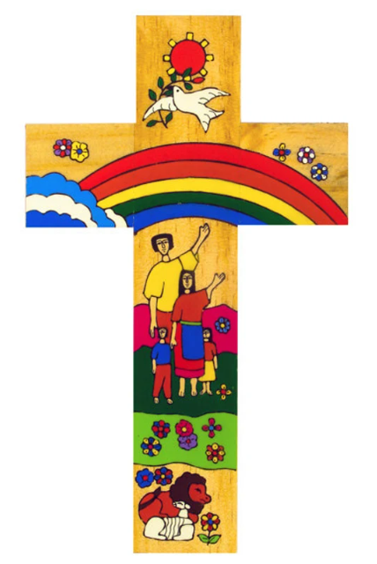
Catholic Social Teaching
Catholic Social Teaching
In PE
A hub of faith and learning with Christ at its centre

Slide 2


Catholic Social Teaching in KS3 PE
Catholic Social Teaching
At KS3 our Healthy Futures strand focuses on developing the whole-student. Our gospel values underpin this strand. We have designed our curriculum to ensure scenarios are created within lessons that allow the focus to move between the physical and affective learning domain. Big concepts such as relationships, kindness, empathy, inclusion, diversity, culture, and respectful collaboration all form parts of termly learning objectives, allowing Catholic Social Teaching to thread through our daily routines in PE.
A hub of faith and learning with Christ at its centre

Slide 3
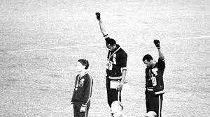
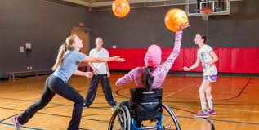
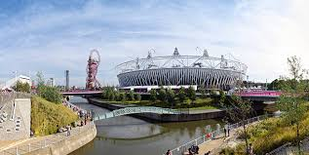
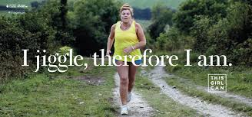

Catholic Social Teaching in KS4 & KS5 PE
Catholic Social Teaching
GCSE and A-level PE provide a fantastic platform to recognise the power of catholic social teaching. This most vivid examples link to the major topics of Sport in Society and Social Cultural Issues in Sport. Modules such as Race, Gender and Disability are underpinned by the values of Human Dignity and Respect. Learning about national initiatives such as ‘This Girl Can’ promotes the message of Solidarity, whilst learning about community projects often targeted at deprived areas to improve health and opportunity, for example the Olympic Stadium, enable us to develop key messages of support for the poor and vulnerable.
A hub of faith and learning with Christ at its centre

